Slide 1
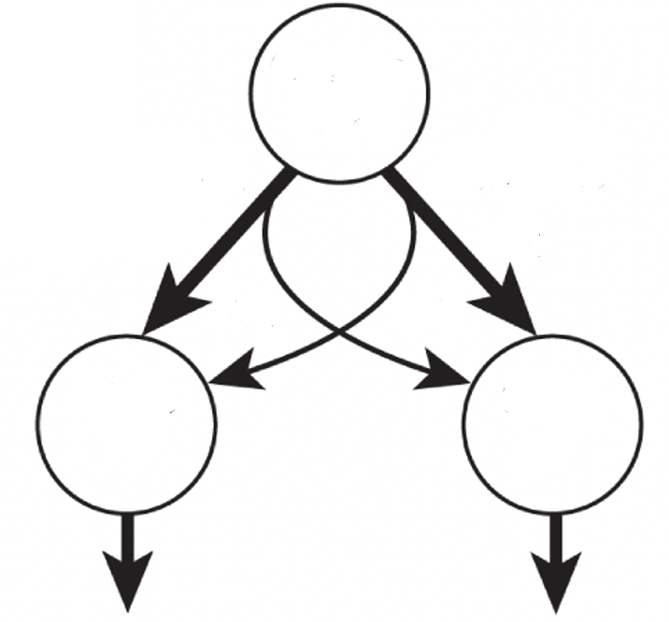







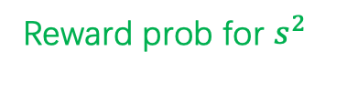
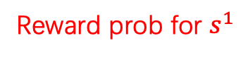







$$s^{0}$$
p(common)
p(common)
0.2
0.2
Reward prob for $s^{1}$
1-p(common)
Reward prob for $s^{2}$
$$s^{1}$$
$$s^{2}$$
$\frac{1}{2}$ p(ambiguity)
observation
$$o^{1}$$
$$o^{2}$$

